Slide 1
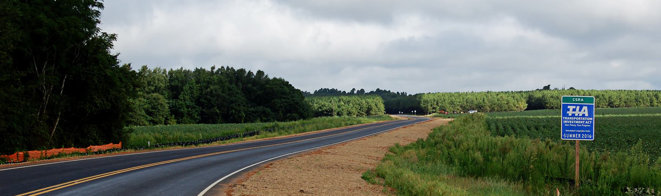
Transportation Investment Act

Slide 2
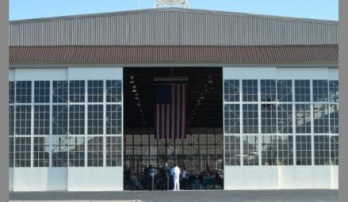
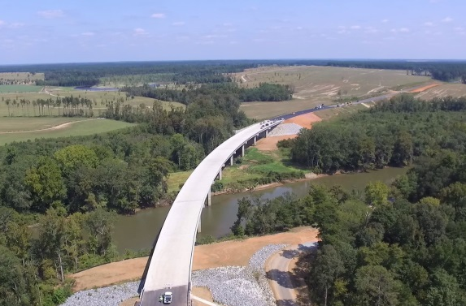
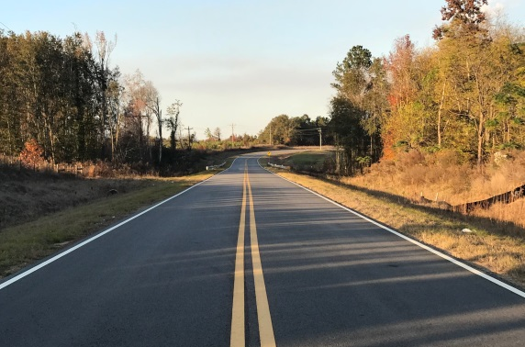
TIA vs T-SPLOST
May 22, 2018 Ballot Question
Shall ________ County’s transportation system and the transportation network in this region and the state be improved by providing for a 1 percent special district transportation sales and use tax for the purpose of transportation projects and programs for a period of ten years?

Slide 3
Regional TIA Process
Majority of Counties pass resolution to initiate the TIA process
City representatives to the Roundtable selected
Roundtable
sets criteria for projects and
elects Executive Committee
Cities, Counties and MPOs submit projects for consideration
Executive Committee reviews list and forms
Constrained Investment List
Public Meetings
GDOT determines which meet the region’s criteria: Unconstrained project list
Election
May 22, 2018
Roundtable considers the Constrained Investment List;
approves a Final Investment List and calls for a vote

Slide 4
Southern GA Executive Committee
Chairman Neal Bennett
Pierce County
Mayor Buddy Duke
City of Adel
Chairman Lace Futch
Atkinson County
Chairman Bill Slaughter
Lowndes County
Mayor John Gayle
City of Valdosta
(Non-Voting Chair)
Chairman Grady Thompson
Tift County

Slide 5
TIA Regions
CSRA
River Valley
HOGA
Southern
Georgia
Notes:
not to exceed $513,649,267 and for a period of time not to exceed ten (10) years duration commencing on October 1, 2018

Slide 6
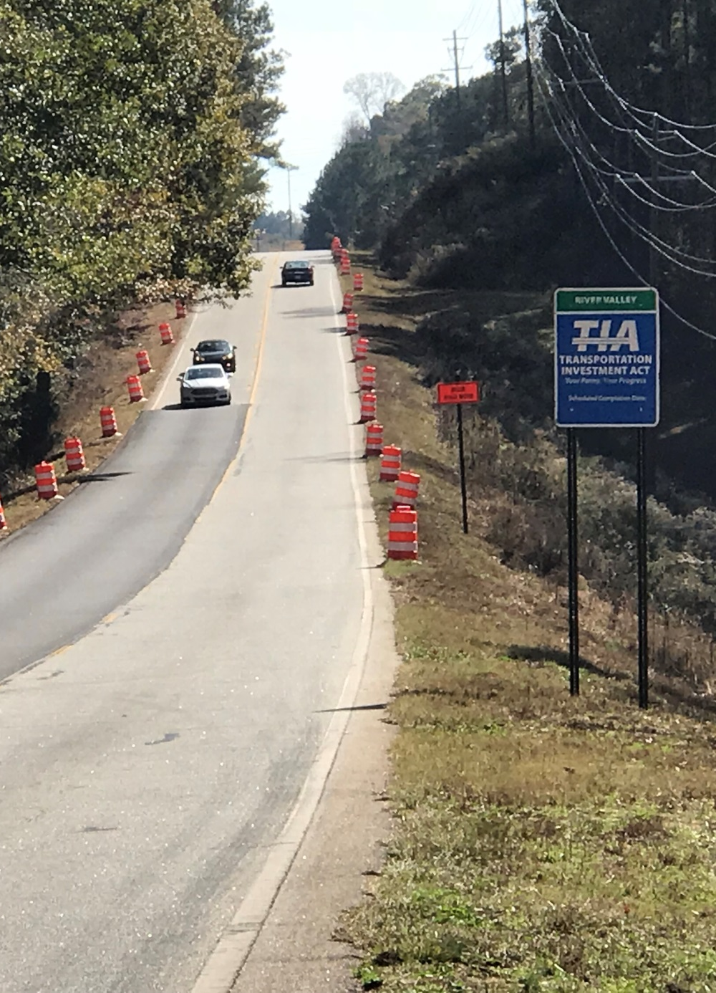
First 6 Years of TIA
521 Projects Advanced to Construction
Notes:
This success has lead CSRA, RV, and HOGA to exploring the next 10 years of the program.
The RCs, GDOT Planning, and GDOT-TIA will assist in developing/vetting the future list.

Slide 7
CSRA Project Overview
84
Total Projects
$538,965,884
Final Investment List
Project Total
17
In Construction
39
Projects Completed
$160,234,172
Total Expenditure to Date
(as of 11.02.18)
Wilkes
Lincoln
Taliaferro
Columbia
McDuffie
Warren
Hancock
Richmond
Glascock
Jefferson
Burke
Washington
Jenkins
Notes:
Status.

Slide 8
HOGA Project Overview
764
Total Projects
$255,524,067
Final Investment List
Project Total
12
In Construction
439
Projects Completed
$89,634,894
Total Expenditure to Date
(as of 11.02.18)
Johnson
Emanuel
Bleckley
Laurens
Treutlen
Candler
Dodge
Montgomery
Evans
Wheeler
Toombs
Wilcox
Telfair
Tattnall
Jeff
Davis
Appling
Wayne
Notes:
Status.

Slide 9
River Valley Project Overview
23
Total Projects
$380,828,512
Final Investment List
Project Total
7
In Construction
7
Projects Completed
$117,177,263
Total Expenditure to Date
(as of 11.02.18)
Harris
Talbot
Taylor
Muscogee
Chattahoochee
Marion
Macon
Schley
Dooly
Stewart
Webster
Sumter
Crisp
Quitman
Randolph
Clay
Notes:
Status.

Slide 10
Revenue Projections and Budget
As of Feb 5, 2018 | 2018-2028
Total Revenue Projected | $513,649,267
75% for Project Investment List | $385,236,950
25% Discretionary Distribution | $128,412,317
Less Project Delivery Cost (4.8%) | ($18,491,374)
Less Inflation (3.6%) | ($69,966,642)
Budget (2017 $) | $296,778,935
GDOT Commitment | $112,000,000
Total Available for Investment List | $408,778,935

Slide 11
Southern GA Project Overview
BEN
HILL
151
Total Projects
$408,763,452
Final Investment List
Project Total
Band 1
84 Projects
Band 2
34 Projects
Band 3
33 Projects
TURNER
IRWIN
COFFEE
BACON
TIFT
BERRIEN
ATKINSON
PIERCE
BRANTLEY
COOK
WARE
LANIER
CLINCH
CHARLTON
BROOKS
LOWNDES
ECHOLS

Slide 12
Southern GA Projects
Project Type | # of Projects
Resurfacing/ Paving | 94
Bridge | 14
Safety/ Operations | 13
Sidewalks | 13
Widening/ Passing Lanes | 10
Airport | 4
Interchange | 2
New Roadway | 1

Slide 13
Southern GA Timeline

Slide 14
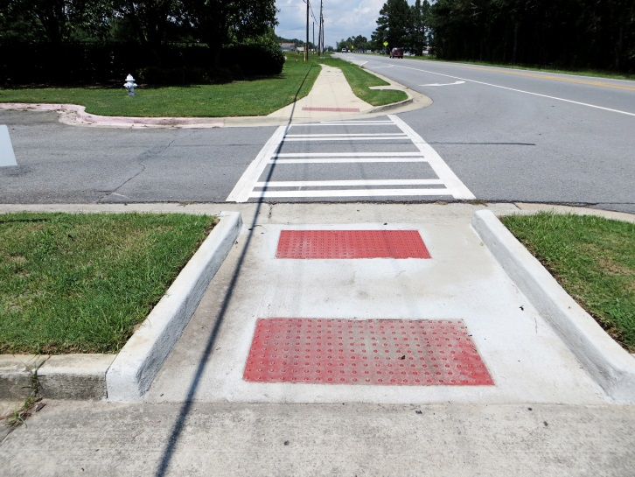
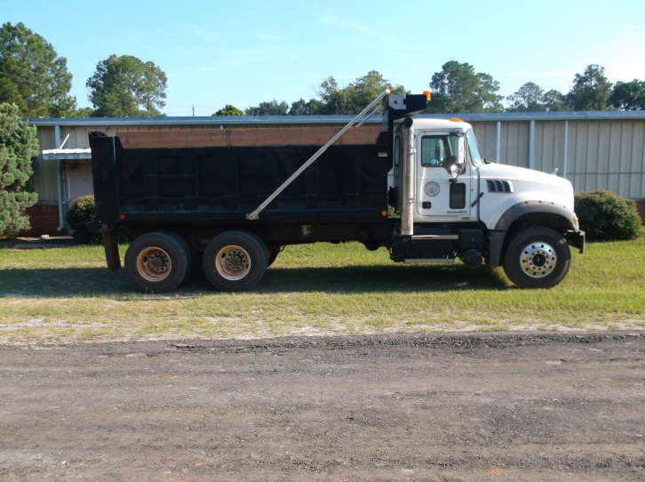
Discretionary Funds
Code Section 48-8-242 (10) provides “Project means, without limitation, any new or existing airports, bike lanes, bridges, bus and rail mass transit systems, freight and passenger rail, pedestrian facilities, ports, roads, terminals, and all activities and structures useful and incident to providing, operating, and maintaining the same. The term shall also include direct appropriations to a local government for the purpose of serving as a local match for state and federal funding.”

Slide 15
Discretionary Funds
Leveraging TIA funds with other transportation initiatives has become a common practice across the TIA regions, especially in the Central Savannah River Area. Burke County Administrator Merv Waldrop said the county is using their 25 percent discretionary funding to resurface county roads and as a local match for the Rural Transit program. “We will resurface every road in the county within the 10 years of the TIA program. The resurfacing would not occur at this pace if we didn’t have TIA, and the funding for transit would have been taken from the General Fund, reducing other programs such as recreation.”

Slide 16
Projected Discretionary Funds Coffee County
Notes:
Population from 2015 Census estimate
Mileage from “2016 GDOT Report”

Slide 17
Agency Roles
GSFIC
GDOT
Tax Collection
Program Management
Dept. of Revenue
Financial
Project Delivery
Consultant or
Local
or
GDOT
October 2018
1st 25% Funds
Dispersed November 30th

Slide 18
The TIA Office
Kenneth Franks
TIA Administrator
(404) 631-1568
kfranks@dot.ga.gov
Eric Wilkinson
TIA Regional Coordinator
CSRA, HOGA, and SG (478) 538-8522 ewilkinson@dot.ga.gov
Brent Moseley
TIA Regional Coordinator
SG & HOGA
(912) 661-7157
bmoseley@dot.ga.gov
William Easton
TIA Regional Coordinator SG & RV
(404) 631-1810
weastin@dot.ga.gov
www.ga-tia.com

Slide 19
TIA Program Management
Program Management Goals
Deliver the program
Manage schedules, budgets & ensure quality
Transparency
Accountability
Consistency in methods & procedures
Provide reporting for the Southern GA Region

Slide 20
TIA Program Management
Responsibilities
Administrative
Financial Controls
Communication
Public Involvement
Technical
Concept Development
Environmental Approvals & Permitting
Concept Validations(local)
ROW Approvals
Utility Coordination
Mgmt of CEI/Testing
QC/QA
Forecasting
Scheduling
Risk Mgmt.
Budget Mgmt.
Audits
Invoicing
Procurement
IGA Coordination
Data Integration
Document Control
Stakeholder Mgmt
Dashboard Reporting
Media Support
Web/Social Media
Engineering Reviews

Slide 21
TIA Website
www.ga-tia.com

Slide 22
Questions?
SUMMER 2019

